Slide 1
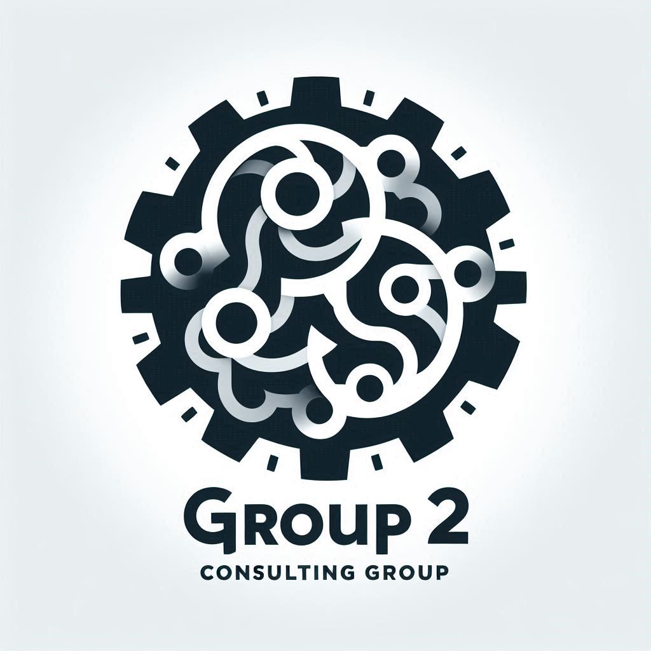
The Group 2 Consulting Group (G2CG)
…an AWS cloud solutions consultancy

Slide 2
Project #1
Client
TechStyle Inc
Project
Optimization and modernization of CustomThread’s infrastructure to improve performance, ensure PCI compliance and reduce day-to-day management efforts
Key Deliverables
Presentation of proposed solution – PowerPoint deck
Proposed architecture
Diagram
Components
Web Tier services and technologies
Database Tier services and technologies
Backup & Recovery strategies
Describe how architecture addresses client’s must-haves
Security Measures for both web and database tiers
How does measures achieve PCI compliance
Availability and Redundancy strategies
Cost Optimization measures
Client Must-Haves
Performance Optimization: application performs well during peak hours
Security and Compliance: Achieve PCI compliance; enhanced security
Scalability: Scalable architecture to handle future growth
Cost Optimization: Must be a cost-efficient solution
Low Maintenance: Requires minimal day-to-day management

Slide 3
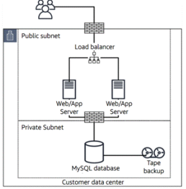
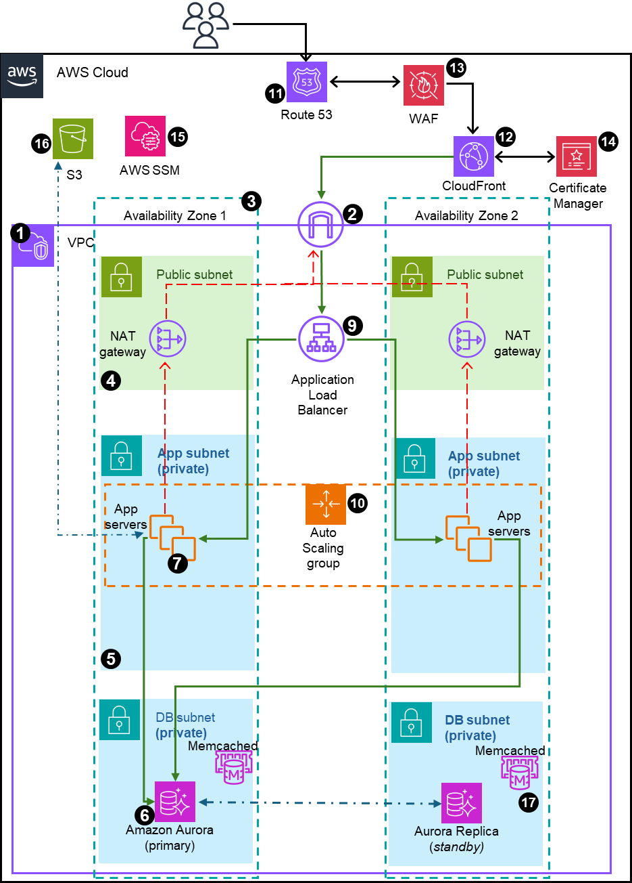
Proposed Solution – High-level Basics
From Here
(on-prem)
To Here
(AWS Cloud)
Replatform CustomThread infrastructure from on-premises to AWS cloud
New network is VPC with multiple AZs (vs single) for high availability & reliability
3-tier architecture with all servers in private subnets for additional security
Right-size servers based on workload history
Add AWS ALB with combined traffic balancing and server health checks
ASG to scale out servers in peak traffic and scale in during down times
Migrate DB to AWS Aurora for speed, multi-AZ replicas, automatic failover, autoscaling (read replica and size scaling)
Add S3 for storage of backups, customer files (images, videos), logs
Enable AWS Backup for automatic backup of DB and Server snapshots
Enable Cloudfront for improved latency and frontline for SSL/TSL data encryption
Enhanced monitoring, alarms and alerts

Slide 4






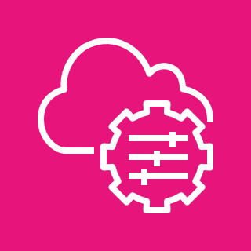












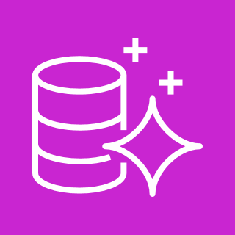
Proposed Architecture
How architecture addresses customer must-haves
Performance
AWS’s ALB performs server health checks and routes traffic only to healthy instances – this ensures only healthy and running instances receive traffic
ASG responds to traffic alarms by adding instances during peak traffic and scaling out when traffic reverts; ASG also responds to health checks by terminating unhealthy instances and spinning up new ones – maintaining availability of adequate resources for client’s workload
Multi-AZ ensures high availability, reliability and ensures client’s applications are almost available and guarantees strong client performance
Aurora DB is an optimized DB with 5X speed of regular DB; Aurora has automatic failover to read replica, ensuring reliability and performance of client’s network; Memcached (optional) is in-memory cache for faster read access.
CloudFront CDN’s caching uses edge locations around the world to reduce latency and improve load times
Automatic Backup into S3 buckets; and S3 is automatically replicated in multiple Azs ensuring reliability of backups and high availability
Security
Web/App tier servers in private subnets (access only through SSM or SSH on a bastion in the public subnet) (NAT gateways only for one-directional internet access)
DB tier instances also in private isolated subnet; NACLs restrict access to traffic from Web/App tier
Security Groups used to control all inbound and outbound traffic
only ALB traffic allowed into the Web/App tier, and SSH port opened to access from public subnet via Bastion
Only traffic from Web/App tier allowed into the DB tier
SSL encryption via AWS Certificates Manager ensures customer’s payment information, personal data, etc. are encrypted while in transit
Data-at-Rest can be enabled for data in S3, DB, EBS, Aurora and Memcached
S3 Access management- restrict public access
4 & 5 above help with PCI compliance
WAF and Shield for application level and network protection against attacks
PCI-Compliance
Several AWS services are covered under the AWS PCI DSS certification (payment card industry data security standard)
EC2 for hosting workloads
S3 for storing cardholder data securely with encryption
Aurora and Memcached for storing payment card data
ELB for securely distributing traffic
Steps we have taken to ensure PCI-compliance (customer size to configure AWS services to ensure PCI-compliance) 1. Encryption: All cardholder information both at rest (in S3 and Aurora) or in transit are encrypted. We added both AWS Certificate Manager for SSL and KMS for at-rest encryption
2. Access control: strong access control using IAM policies, principle of Least Privilege, and MFA for accounts
3. Monitoring & Logging: set up monitoring and alerts with centralized management (Cloudwatch, Cloudtrail, etc)
4. Patch Updates using SSM patch manager for vulnerability management
Scalability for future group
New subnets can be added to existing VPC to for additional resources
ASG can scale-out as much as needed to support growth
S3 storage automatically scales for more capacity
Aurora DB can add read replicas for read scaling, as well as DB storage scaling; also supports cross-region replication
Serverless options available for infinite scaling
Cost Optimization
Reserved instances and on-demand during scale-out
AWS tools – Cost Explorer and Budget- for line of sight to costs management
S3 tiers and lifecycle policies to save costs
Low Maintenance
AWS Backup for automated backup with retention policies
Aurora DB is managed services – automatic backup, automatic failover, and automatic scaling with little manual intervention
ASG handles server scaling automatically on demand
Monitoring & Alerts alarms based on thresholds, and SNS for alerts; also can use managed services like Lambda to create automatic actions triggered by alarms
SSM patch manager for automatic patching of managed instances with timely security updates
AWS CloudFormation automates provisioning, management, deployment and retirement of resources
Automatic tracking of costs and budgets via cost explorer
VPC with public and private subnets in 2 availability zones
Internet Gateway to allow communication between instances in VPC and internet
Two Availability Zones for high availability and fault tolerance
Public subnet to house resources like NAT gateway, Application Load Balancers and Bastion (we will replace bastion with SSM session manager)
App and DB servers will be placed in Private subnets
AWS Aurora with primary and replica mysql databases in different AZ to ensure high availability and resilience to failures
EC2 instances with the appropriate IAM roles and permissions to host web application
Amazon EFS to allow application to access shared storage ensuring persistent storage across instances
Application Load Balancer (ALB) to distribute traffic across an auto-scaling group of EC2 instances in multiple AZs.
Auto Scaling Group (ASG) to dynamically create EC2 instances to make web application highly available, scalable, fault-tolerant and elastic
Route 53 to set up DNS, direct traffic and domain management, and failover
CloudFront for global content caching, and SSL termination for data-in-transit encryption
WAF to protect application from web attacks that will compromise security consume resources and affect availability
Certificate Manager to create and manage the SSL/TSL encryption certification
Systems Manager to manage the resources – session manager for access (w/o need for ssh or bastion), patch manager for updates, etc
S3 to store static files, static website for failover, and back-up storage, and general storage
Backup using AWS Backup for S3 and DB
AWS Key Management Service (KMS)
Other possible architecture considerations
Integrate monitoring and alerting – CloudWatch, etc
Improved governance – use AWS Control Tower to create Ous – Security OU, Test OU, DevOps OU and Production OU
18
AWS Cloud
13
AWS
KMS
AWS Backup
11
17
Route 53
WAF
15
12
14
16
AWS SSM
CloudFront
Certificate Manager
S3
3
Availability Zone 1
2
Availability Zone 2
1
VPC
Public subnet
Public subnet
NAT gateway
9
NAT gateway
4
Application
Load Balancer
App subnet (private)
App subnet (private)
Auto
Scaling
group
App servers
10
App servers
7
5
DB subnet (private)
DB subnet (private)
Memcached
Memcached
6
17
Amazon Aurora (primary)
Aurora Replica
(standby)

Slide 5
Description of Architecture Number Callouts
VPC with public and private subnets in 2 availability zones
Internet Gateway to allow communication between instances in VPC and internet
Two Availability Zones for high availability and fault tolerance
Public subnet to house resources like NAT gateway, Application Load Balancers and Bastion (we will replace bastion with SSM session manager)
App and DB servers will be placed in Private subnets
AWS Aurora with primary and replica mysql databases in different AZ to ensure high availability and resilience to failures
EC2 instances with the appropriate IAM roles and permissions to host web application
Amazon EFS to allow application to access shared storage ensuring persistent storage across instances
Application Load Balancer (ALB) to distribute traffic across an auto-scaling group of EC2 instances in multiple AZs.
Auto Scaling Group (ASG) to dynamically create EC2 instances to make web application highly available, scalable, fault-tolerant and elastic
Route 53 to set up DNS, direct traffic and domain management, and failover
CloudFront for global content caching, and SSL termination for data-in-transit encryption
WAF to protect application from web attacks that will compromise security consume resources and affect availability
Certificate Manager to create and manage the SSL/TSL encryption certification
Systems Manager to manage the resources – session manager for access (w/o need for ssh or bastion), patch manager for updates, etc
S3 to store static files, static website for failover, and back-up storage, and general storage
Backup using AWS Backup for S3 and DB
Other possible architecture considerations
Integrate monitoring and alerting – CloudWatch, etc
Improved governance – use AWS Control Tower to create Ous – Security OU, Test OU, DevOps OU and Production OU

Slide 6
How Architecture Address Customer Needs
Performance
AWS’s ALB performs server health checks and routes traffic only to healthy instances – this ensures only healthy and running instances receive traffic
ASG responds to traffic alarms by adding instances during peak traffic and scaling out when traffic reverts; ASG also responds to health checks by terminating unhealthy instances and spinning up new ones – maintaining availability of adequate resources for client’s workload
Aurora DB is an optimized DB with 5X speed of regular DB; Aurora has automatic failover to replica, ensuring reliability and performance of client’s network ; Memcached (optional) is in-memory cache for faster read access
CloudFront CDN’s caching uses edge locations around the world to reduce latency and improve load times
Automatic Backup into S3 buckets; and S3 is automatically replicated in multiple Azs ensuring reliability of backups and high availability
Multi-AZ ensures high availability, reliability and ensures client’s applications are almost always available , guaranteeing strong client performance
Security
Web/App tier servers in private subnets (access only through SSM or SSH on a bastion in the public subnet) (NAT gateways only for one-directional internet access)
DB tier instances also in private isolated subnet; NACLs restrict access to traffic from Web/App tier
Security Groups used to control all inbound and outbound traffic
only ALB traffic allowed into the Web/App tier, and SSH port opened to access from public subnet via Bastion
Only traffic from Web/App tier allowed into the DB tier
SSL encryption via AWS Certificates Manager ensures customer’s payment information, personal data, etc. are encrypted while in transit
Data-at-Rest encryption can be enabled for data in S3, DB & Memcached
S3 Access management- restrict public access, VPC endpoints to access
4, 5 & 6 above help with PCI compliance
WAF and Shield for application level and network protection against attacks

Slide 7
How Architecture Address Customer Needs
PCI-Compliance
Several AWS services are covered under the AWS PCI DSS certification (payment card industry data security standard)
EC2 for hosting workloads
S3 for storing cardholder data securely with encryption
Aurora and Memcached for storing payment card data
ELB for securely distributing traffic
Steps we have taken to ensure PCI-compliance (customer size to configure AWS services to ensure PCI-compliance)
Encryption: All cardholder information both at rest (in S3 and Aurora) or in transit are encrypted. We added both AWS Certificate Manager for SSL and KMS for at-rest encryption
Access control: strong access control using IAM policies, principle of Least Privilege, and MFA for accounts
Monitoring & Logging: set up monitoring and alerts with centralized management (Cloudtrail for account API calls logging)
Patch Updates using SSM patch manager for vulnerability management
Scalability for future group
New subnets can be added to existing VPC to for additional resources
ASG can scale-out as much as needed to support growth
S3 storage automatically scales for more capacity
Aurora DB can add read replicas for read scaling, as well as DB storage scaling; also supports cross-region replication
Serverless options available for infinite scaling
Cost Optimization
Reserved instances and on-demand pricing during scale-out
AWS tools – Cost Explorer and Budget- for line of sight to costs management
S3 tiers and lifecycle policies to save costs

Slide 8
How Architecture Address Customer Needs
Low Maintenance
AWS Backup for automated backup with retention policies
Aurora DB is managed services – automatic backup, automatic failover, and automatic scaling with little manual intervention
ASG handles server scaling automatically on demand
Monitoring & Alerts alarms based on thresholds, and SNS for alerts; also, can use managed services like Lambda to create automatic actions triggered by alarms
SSM patch manager for automatic patching of managed instances with timely security updates
AWS CloudFormation automates provisioning, management, deployment and retirement of resources
Automatic tracking of costs and budgets via cost explorer

Slide 9
Performance Optimization (Yvette)
To ensure that this architecture solved the performance issues that Custom Thread faced while working on premise, the following tools have been incorporated into their cloud environment
Amazon ElastiCache (Memcached)
Fast temporal storage for frequently used data ( session data, API responses), hence reduces latency.
Reduces the tendency of over laboring the database.
Permits scaling in or scaling out without experiencing downtime.
Cloud Front
Leverages edge locations to bring content closer to users thus reducing latency.
Application Load Balancer
Performs health checks on instances and route incoming traffic only to heathy instances
Automatically integrates with the auto scaling group to automatically adjust the number of instances based on work load.
Provides session stickiness.
Auto Scaling Group
Dynamically adjusting the number of instances based on workload.
Little to no manual intervention
Cost effective.
Amazon Arora
Offers 5 times higher performance compared to the normal my SQL database.
Fast failover.
Storage auto-scaling.

Slide 10
Security (Leonard)
Slide 9: Security Measures (IAM, Network security SG,SSL encryption, WAF, Application Security(guard duty, AWS Macie)
Access Control using IAM and MFA
Security Group/ NACLs
Encryption – Data-at-rest (KMS) and Data in transit (SSL)
Monitoring, alerting & logging – Cloudtrail
WAF & Shield
Macie & GuardDuty
I would implement robust Identity and Access Management security measures, starting by assigning the Principle of Least Privilege granting users and services the required permissions (Roles, define policies, and check permissions) they need to perform a specific task or their job functions.
I would set up MFA that would act as a second form of verification.
At the level of my network security, I will implement the right security group rule that would help control the traffic for all Ec2 instances ( inbound and outbound) and I would ensure my NACLs are available to control traffic at the level of the subnet.
I would Implement SSL/TLS (Secure Sockets Layer/Transport Layer Security) to secure my data in transit between clients and servers,
I will be setting up my guardduty to detect threats and monitor malicious or unauthorized behavior.
I will be setting up Amazon Macie to fully manage data security and data privacy services that use machine learning.

Slide 11
Availability and Redundancy (Precious)
Multi-AZ Deployment
I would utilize Multi-region deployments to ensure disaster recovery and minimal downtime by seamlessly transitioning between regions or zones for the client
By using two Availability zones ensures the clients infrastructure remains operational.
Aurora: Failover Mechanisms
Automatic Failover
In the event of a primary instance failure, Aurora will automatically promote a read replica to become the new primary for the client
Read Replicas
Aurora replicates data across multiple read replicas, allowing for read operations to be distributed across different servers ensuring reliability and strong performance for the clients network
Redundant Hardware
I would utilize redundant software services and hardware components like network switches, routers, and storage devices to prevent single points of failure and maintain continuous operation.
By incorporating redundant hardware into CustomThread’s infrastructure ensures that the infrastructure remains operational and reliable.
Redundant Databases
Database replication: Data is replicated at the same time to a standby server, providing data redundancy and the ability to switch to the standby server if the primary fails.
Backup and Recovery
Disaster Recovery: Ensures that applications and data remains available and recoverable for our client in the event of a significant disruption.
Create a detailed disaster recovery plan for our client that outline steps to restore services in case of a major outage.
Regular Backups: Schedule regular automated backups for application data and database instances.

Slide 12
Cost Optimization (Kingsley)
The EC2 reserve pricing model would be used in this scenario to optimize the AWS cost as it offers significant discounts on on-demand instances for a specific period.
Below are the key benefits of using the AWS EC2 reserve pricing model includes;
Cost Saving: The client can have significant savings on cost of up to 75% when compared to the on-demand pricing.
Predictable Pricing: There are no surprises on the cost of the instances as the client knows how much they will pay for their EC2 instances and will be able to make long term financial plan for the associated cost.
Long-Term Commitment: The client can benefit from long-term planning and stability from the use of the EC2 instances because they can be reserved for a period of 1 – 3 years.

Slide 13
Low Maintenance (Leslie)
Types of Montoring and Alerts
CloudWatch/CloudWatch Logs* is the most cost optimized which means low cost
CloudTrail
VPC Flow Logs
CloudWatch/ CloudWatch Logs can be used to monitor applications and systems using log data
For example CloudWatch logs can track the number of errors that occur in your application logs and send a notification whenever
When you sign up for AWS ,you can get started with CloudWatch Logs for free using the AWS free tier
Log retention can be set which means you can set a period of time in which your data will be stored with CloudWatch logs
Automation
CICD pipeline
When new code is submitted on one end of an AWS environment that new is tested over a series of stages such as
source
build
Test
Staging
Production
Then that code is published as a production-ready code

Slide 14
Scalability (Adaobi)
VPC Scalability
New Subnets: Easily add new subnets to company's existing VPC to accommodate additional resources and services.
Compute Scalability
Auto Scaling Group( ASG): Automatically adjusts the number of instances in the application to handle increased load, ensuring optimal performance during peak times.
Storage Scalability
Amazon S3: Seamlessly scales to store and manage unlimited amounts of data, accommodating company's growing storage needs.
Database Scalability
Amazon Aurora
Read Scaling: Add read replicas to distribute read operations, enhancing performance.
Storage Scaling: Automatically increases database storage as needed.
Cross-Region Replication: Supports global replication for multi-region applications.
Serverless Scalability
Serverless Services( Lambda): AWS Lambda and other serverless options offer automatic scaling to accommodate any level of demand without server management.

Slide 15
Web/App Tier Description (Olayinka)
Bla bla bla

Slide 16
Database Tier Description (Prince)
Databases
Aurora MySQL
In this project we will be using an Aurora MySQL database to store our data in an column and row format. This is beneficial because a relational database can store a large amount of data in an organized schema allowing Custom Threads to make fast and reliable queries.
Using Aurora MySQL improves Performance with its fast throughput. Amazon Aurora is up to five times faster than a standard SQL database. Aurora’s Parallel query execution engine and separation of compute and storage allows it to make the most of its resources.
Private Subnet
Placing your DB instance in a private subnet enhances security and protects your database from threats from other sources.
You can use security groups and NACLS to control the inbound and outbound rules. This gives Custom Threads more control over who can access their database.
PCI Compliance
Using Aurora MySQL you can encrypt your data at rest and in transit using TLS/SSL certificates this will be beneficial to Custom Threads as this will help them adhere to the PCI Compliance rules
High Availability
Aurora MySQL can be deployed in multiple Az's so there is constant data replication of data between the databases so when one goes down the other is ready to be used. This provides Custom Threads with availability in case of failures. Aurora allows users to create up to 15 read replicas for a single database cluster.
Memcached: Increases application resilience by distributing cache data across multiple servers, reducing the risk of single points of failure.
Reducing Day to Day Management
Amazon Aurora is a fully managed AWS service meaning the user doesn’t have to worry about the infrastructure setup, software patching, monitoring and backups. This will help reduce day to day management and Custom Threads will be able to focus on their core business activities

Slide 17
Backup & Recovery (Alain)
The first thing to building a robust disaster recovery stategy to ensure business Continuity is to couduct a business inpact analysis for each application.
2.. based on the result I will set two metrics.
Metrics 1.) Recovery point objective (RPO) this is the maximun amount of acceptable data that can be loss from an application using time for if we had a disaster a 9pm and we set our (RPO)to 1 hour we can recover data up to 8pm.
Metrics 2.) Recovery time objective (RTO) this is the maximum amount of time an application can be sown after a diaster. 3o min – an hour.
The are 4 main strategry we can use for our disaster recovery on a (AWS)
1 back up and restore: this creating backups of your application and restore them in case of a disaster. This uses Eb snapshots and images from running instances but this is moslty used for low priority application and it offers the highest RPO and RTO.
2. pilot light we can run core services in a stanby mode an replicate data in another region using infrasture as code ready to deploy incase of a disaster this also has less RPO and RTO than back up but expensive
3. warm standby: we can run a scaled down version of our primary eniroment this get us lesser RPO and RTO than both pilot light and backup and restore
4. Active- Active we have two active enviroment primary and secondary with the same resources. This is not cost- effective and it cost too much.
The most cost – effective (DR) would be EBS snapshort: this involves creating snapshots of the EBS volume and transtering it to another rgion in an s3 buket.
Take note this are distaster recovery stategy on the level of the instance.
Since we are using Aurora which is a nonrelational database service(RDS) Aws has optimize with additional features like back up and retention.
So we can use AWS backup because it is easily intergrates with RDS and other severice to backup data . This provides a centralized management of all your backup.

Slide 18
Obee- brain dump
 | Feature | Existing Platform | New Platform (AWS Cloud)
Network & Infra | Network | Private network (data center) | VPC
 | Subnets | Two - one public and one private Not scalable | 3-tier but scalable - can add more subnets for even more isolation of resources
 | Load balancer | Load balancer | Application load balancer
 | Servers | 2 Application servers | On-demand scalability - can scale out to 4 (or more), scale in to 1 can vertically scale to higher performance servers if needed
 | DB | MySQL | AWS Aurora w/ MySQL - highly scalable (read replicas), faster, highly available across multi-Azs, automatic failover
 | Storage / backup | Weekly backup, on-Tape storage for DB | Continuous backup with AWS Backup to S3 AWS S3 is on auto replication across multiple Azs
Performance | Load distribution | Yes | Yes - ALB goes beyond to performance health checks
 | Scaling for peak traffic | No - constrained to 2 servers | Yes - can scale out (and scale in to save costs) using ASG
 | DB access | MySQL - base speed, base storage | Aurora MySQL optimized for 5X speed (distributed storage) -scalable read capacity with up to 15 read replicas -auto-scaling of storage -optional Memcached for even faster read access
 | Web latency improvement | None | AWS CloudFront using Edge locations for global caching, reduced latency

Slide 19
Obee- brain dump
 | Feature | Existing Platform | New Platform (AWS Cloud)
Security & PCI Compliance | Servers & DB vulnerability | - Web & App servers are in public subnet and highly vulnerable DB is in private subnet | Web & App servers in private subnets with NAT gateway for one-directional access to internet (ssh via bastion host or SSM session manager needed for access) DB and replicas are in private subnets
 | Firewalls: Security Groups & NACLs | Not clear | Yes, controls access (inbound & outbound traffic) to the instances (servers and DBs) and subnets
 | Data encryption | Not clear | TSL/SSL encryption via AWS Certificate Manager -protects customer data (credit card info, etc) from interception Optional data-at-rest encryption (s3, EBS & RDS), uses AWS KMS
 | Network and Application Layer Protection | None | AWS WAF(paid) protects from web exploits - SQL injection, etc using custom rules to block traffic AWS Shield (free) protects against DDoS
 | IAM | None | Account access management - Roles for applications, MFA for users, permission (least privilege permission) and Groups management
 | Logging | None | Highly advanced logging tools for threat monitoring & detection How-to: store logs in S3; Athena to Query; Quicksights to analyze and visualize Log-types for sucurity: -AWS Config- monitor and log security-related changes in AWS resources, such as security groups, IAM roles, and S3 bucket policies -AWS CloudTrail- to log API calls, and track user activity, detect unauthorized access, and audit AWS account activities -CloudWatch- to monitor application and infrastructure logs for security anomalies, like unauthorized login attempts or unusual error rates -VPC Flow Logs- to monitor network (IP) traffic and detect anomalous traffic patterns that may indicate security incidents. -GuardDuty- Detect potential security threats, such as EC2 instances compromised by malware, unusual API activity -WAF Logs- monitor for web application threats such as SQL injection or cross-site scripting (XSS) attacks -AWS Security Hub - centralize security findings and insights

Slide 20
Obee- brain dump
 | Feature | Existing Platform | New Platform (AWS Cloud)
High Availability / Fault Torelance / Redundancy / Reliability | Zonal Redundancy | One zone only - Servers & DB on one zone -risk of complete failure if location is compromised | Two or more Availability zones -ensure HA in case one or more zones are down -new servers can be spin up in healthy zones -DB replication in multiple AZ
 | Servers | Two servers only - if one is unhealthy and down, remaining can be over-worked and crash | ALB monitors health of servers and ASG can retire unhealthey and spin up new healthy serves to keep workload within tolerance
 | DB | One DB, no replication, backup and manual recovery in case of failure | One DB and multiple replicas; failover to replica is automatic ensuring reliability
 | Storage | File storage (customer images, metadata, etc) stored in server instances or DB | S3 used to store customer-generated or uploaded images DB used to metadata storage
 | Backup / Recovery | Back-up on Tape, failure of tape is relliability issue | Backup into S3 buckets; and S3 buckets are replicated in multiple AZs - ensures high availablity and reliabilty of backups when needed
 | Feature | Existing Platform | New Platform (AWS Cloud)
Cost Optimization | Infrastruture cost | One time cost; difficult to plan for scale | Pay for resources used and data transferred - optimize resource choice - i.e. choose the right instance type based on workload -Use S3 storage tiers and lifecycle policies to save costs -Use DB Autoscaling to add additional storage to DB (pay for necessary capacity only) - use Reserved Instanced (or Savings Plan) for Desired # of servers; use On-Demand for scale-out during peak traffic - AWS cost explorer and AWS budgets to track and manage spending; use dashboard to track
Scalability | Network | Discrete, will need to physically add new infrastructure | -Many options to scale as business grows 1. Servers can be added via ASG and hooked up to the ALB 2. New subnets can be created on existing VPC for additional resources 3. S3 is scalable storage and automatically svales 4. Aurora DB can scale - more read replicas to distribute read traffic and multi-AZ deployment for HA and failover; Also supports cross region replication 5. Option for serverless migration - infinitely scaling services
Low Maintenance |  | None | -Automated backup with retention policies via AWS Backup -Use AWS Managed Services -Aurora DB provides automatic backup, automatic failover and automatic scaling with minimal manual intervention -ASG handles server scaling automatically based on demand -Monitoring & Alerts: set up alarms based on thresholds, and SNS for alerts; also can use managed services like Lambda to create automatic actions triggered by alarms -SSM patch manager for automatic patching of managed instances with timely security updates -AWS CloudFormation automates provisioning, management, deployment and retirement of resources -Automatic tracking of costs and budgets via cost explorer

Slide 21
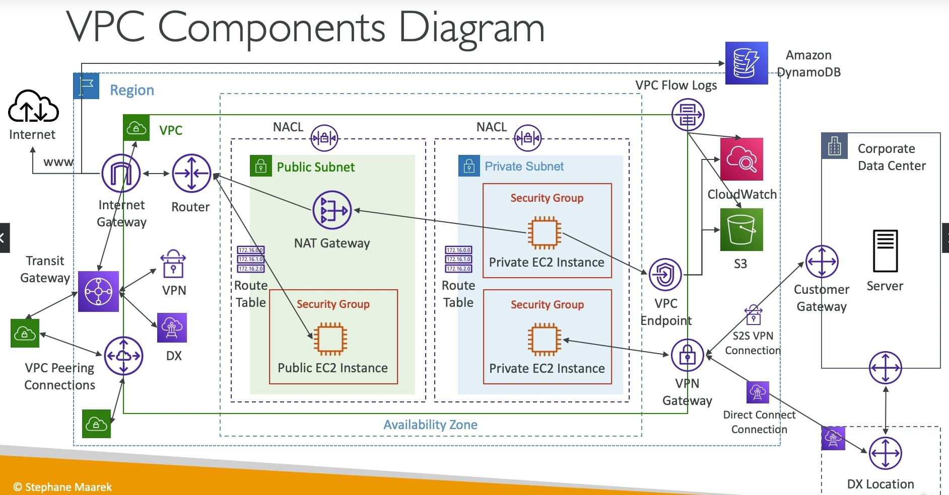

Slide 22
Back-ups
VPC with public and private subnets in 2 availability zones
Internet Gateway to allow communication between instances in VPC and internet
Two Availability Zones for high availability and fault tolerance
Public subnet to house resources like NAT gateway, Application Load Balancers and Bastion (we will replace bastion with SSM session manager)
App and DB servers will be placed in Private subnets
AWS Aurora with primary and replica mysql databases in different AZ to ensure high availability and resilience to failures
EC2 instances with the appropriate IAM roles and permissions to host web application
Amazon EFS to allow application to access shared storage ensuring persistent storage across instances
Application Load Balancer (ALB) to distribute traffic across an auto-scaling group of EC2 instances in multiple AZs.
Auto Scaling Group (ASG) to dynamically create EC2 instances to make web application highly available, scalable, fault-tolerant and elastic
Route 53 to set up DNS, direct traffic and domain management, and failover
CloudFront for global content caching, and SSL termination for data-in-transit encryption
WAF to protect application from web attacks that will compromise security consume resources and affect availability
Certificate Manager to create and manage the SSL/TSL encryption certification
Systems Manager to manage the resources – session manager for access (w/o need for ssh or bastion), patch manager for updates, etc
S3 to store static files, static website for failover, and back-up storage, and general storage

Slide 23


VPC with public and private subnets in 2 availability zones
Internet Gateway to allow communication between instances in VPC and internet
Two Availability Zones for high availability and fault tolerance
Public subnet to house resources like NAT gateway, Application Load Balancers and Bastion (we will replace bastion with SSM session manager)
App and DB servers will be placed in Private subnets
AWS Aurora with primary and replica mysql databases in different AZ to ensure high availability and resilience to failures
EC2 instances with the appropriate IAM roles and permissions to host web application
Amazon EFS to allow application to access shared storage ensuring persistent storage across instances
Application Load Balancer (ALB) to distribute traffic across an auto-scaling group of EC2 instances in multiple AZs.
Auto Scaling Group (ASG) to dynamically create EC2 instances to make web application highly available, scalable, fault-tolerant and elastic
Route 53 to set up DNS, direct traffic and domain management, and failover
CloudFront for global content caching, and SSL termination for data-in-transit encryption
WAF to protect application from web attacks that will compromise security consume resources and affect availability
Certificate Manager to create and manage the SSL/TSL encryption certification
Systems Manager to manage the resources – session manager for access (w/o need for ssh or bastion), patch manager for updates, etc
S3 to store static files, static website for failover, and back-up storage, and general storage
Add Backup using AWS Backup for S3 and DB
Other possible architecture considerations
Integrate monitoring and alerting – CloudWatch, etc
Improved governance – use AWS Control Tower to create OUs – Security OU, Test OU, DevOps OU and Production OU
Migration
AWS Cloud
13
11
Route 53
WAF
16
15
12
14
S3
AWS SSM
CloudFront
Certificate Manager
3
Availability Zone 1
2
Availability Zone 2
1
VPC
Public subnet
Public subnet
NAT gateway
9
NAT gateway
4
Application
Load Balancer
App subnet
App subnet
Auto
Scaling
group
App servers
10
App servers
7
EFS mount target
8
EFS mount target
5
Amazon EFS
DB subnet
DB subnet
Memcached
Memcached
17
6
Amazon Aurora (primary)
Aurora Replica
(standby)

Slide 24
Narrative: How this architecture resolves Custom Thread issues
High Availability and Redundancy
(multiple Azs, automatic backups, ALB, Replica DB)
Performance and Scalability (able to handle load at all times of the day, ASG, EFS for shared drive)
Security & PCI compliance for payment processing
SSL encryption
WAF to protect against attack
VPC to isolate and using security group rules, NACLs, private subnets and session manager (no ssh port) to improve security
IAM roles to connect to other AWS resources e.g. EC2 to DBs
Cost Optimization
Low Maintenance (minimal day-to-day management)
Other considerations
Latency improvement using CloudFront
Stickiness of sessions
S3 for static storage – backups, failover
Disaster recovery – backups of EFS in S3, backup of DBs
Backup and Recovery

